Slide 1

North South University
Department of Electrical and Computer Engineering
School of Engineering and Physical Sciences
Summer, 2019
Group Project
EEE154: Engineering Drawing
Section: 13
Course instructor: Akid Ornob (AKO)

Slide 2
Group- C
Md Sharif Hossain
Md. Masudul Haque
Md. Shovon-al-yakin

Slide 3
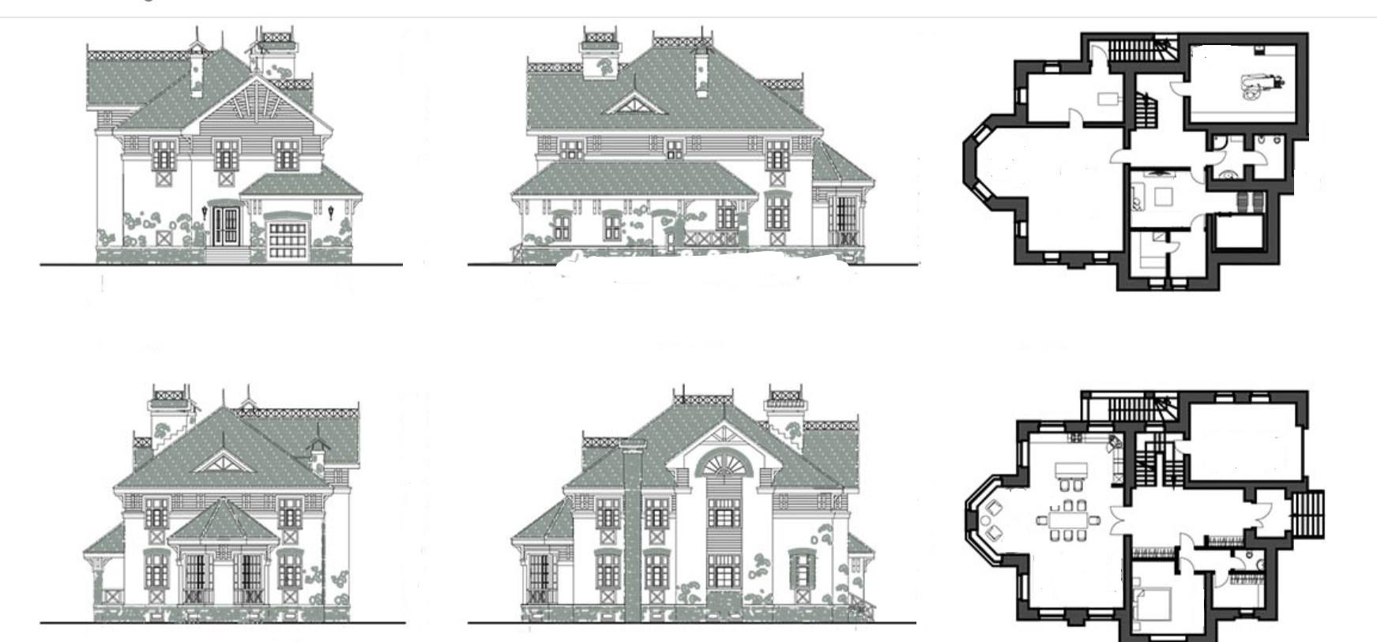
Topic: 2D sketch of a complete house design
Figure 1: Reference image

Slide 4
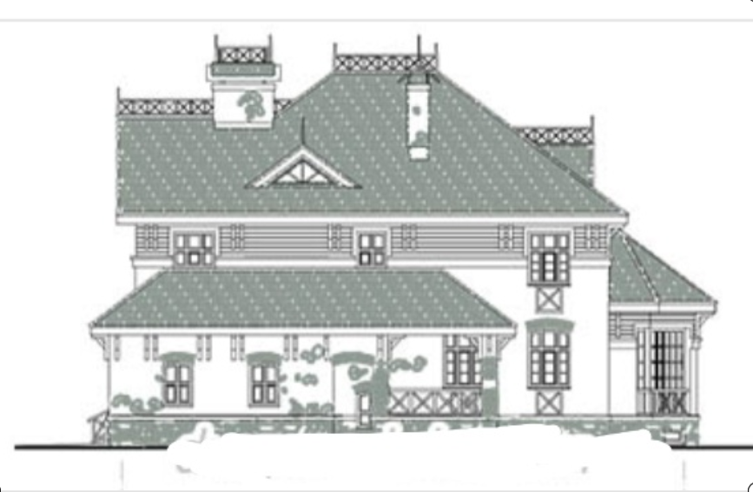
Outside shape: Right view (C-D)
Figure 2: Reference image of right view

Slide 5
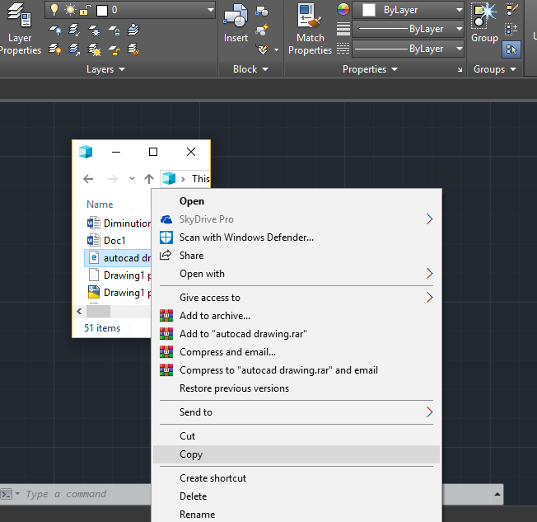
Step 1: Inserting reference image
Copying the reference image using “copy” option or “Ctrl + C”
Figure 3: Copying ref image

Slide 6
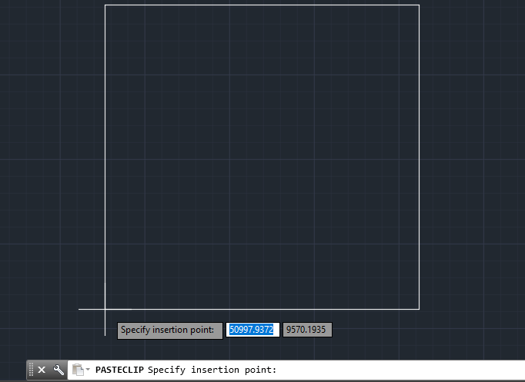
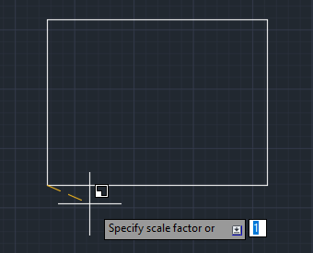
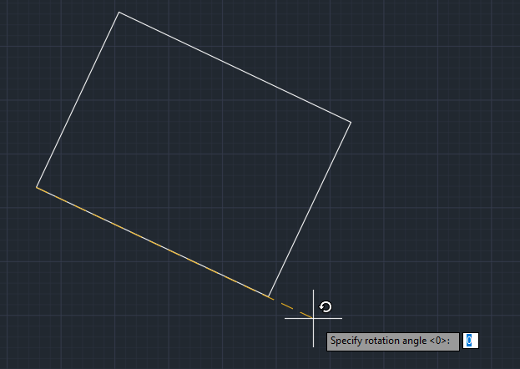
Step 1: Inserting reference image
Pasting image and setting size and angle
Figure 4: Press “Ctrl+v”
Figure 5: Scaling
Figure 6: Angle Position

Slide 7
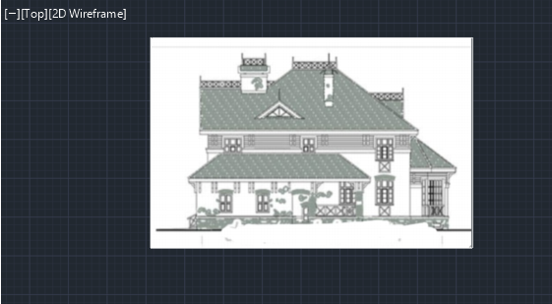
Step 1: Inserting reference image
Image was copied successfully in 2D wireframe (Drafting and annotation).
Figure 7: Image copied

Slide 8
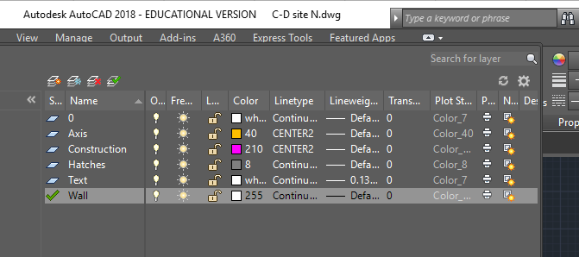
Step 2: Defining layers
There were 6 Layers used.
0
Axis
Construction
Hatch
Text
Wall
Figure 8: Various layers were defined

Slide 9
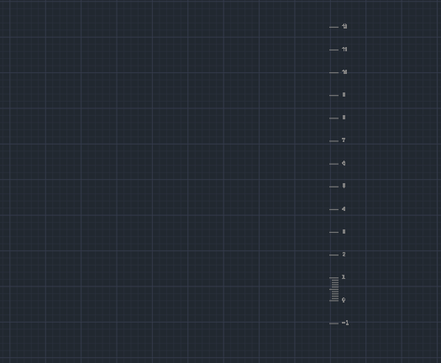
Step 3: Plotting scale
A unique scale was used by every member to maintain the same size.
Figure 9: Drawing scale was plotted

Slide 10
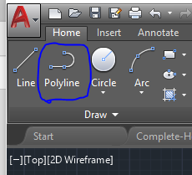
Step 4: Sketching
We used tracing over the reference image using polylines.
Figure 10: Selecting Polyline

Slide 11
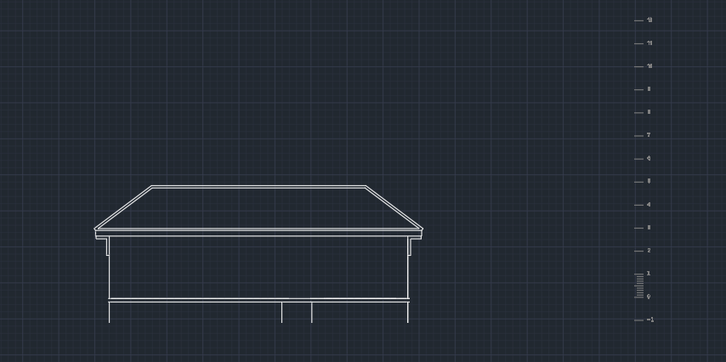
Step 4: Sketching
Figure 11: Initial shape

Slide 12
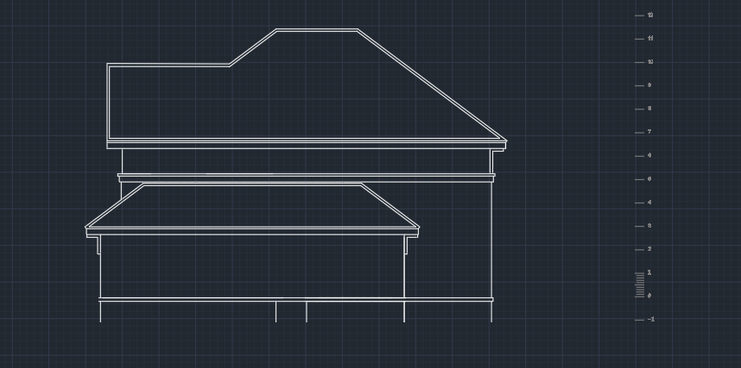
Step 4: Sketching
Figure 12: Total basic shape

Slide 13
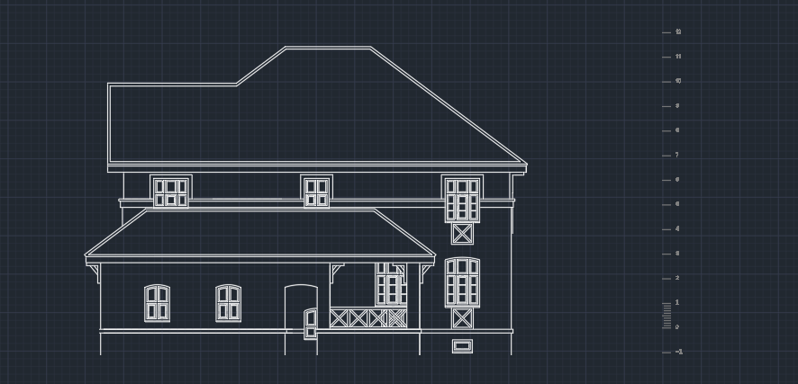
Step 4: Sketching
Figure 13: Added balcony, side door and windows

Slide 14
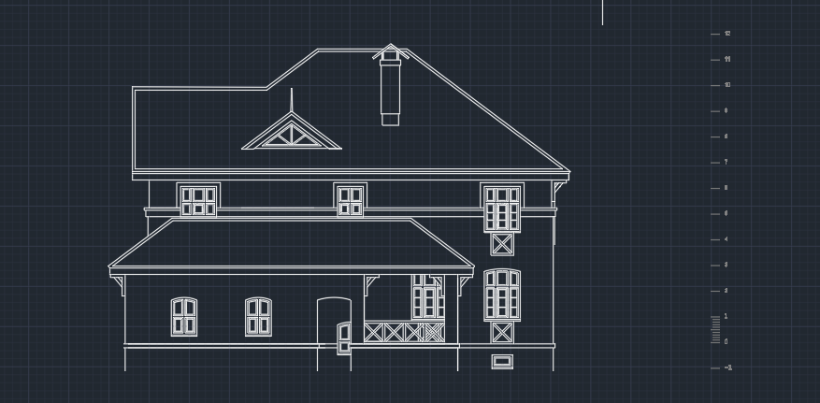
Step 4: Sketching
Figure 14: Added fireplace and roof window

Slide 15
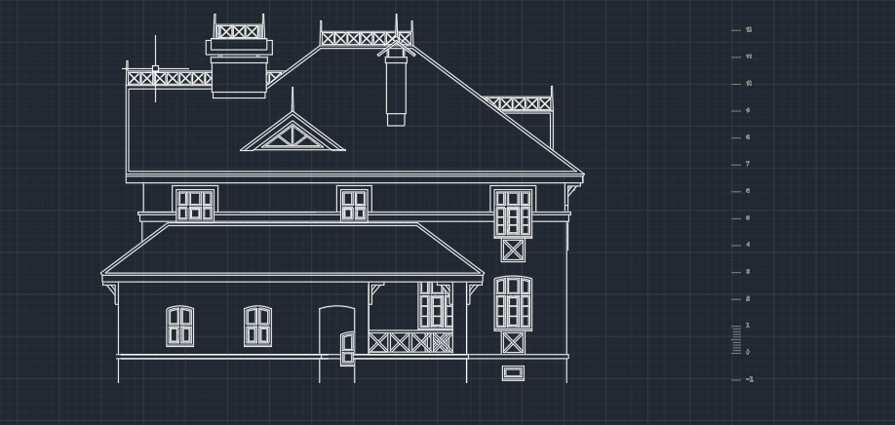
Step 4: Sketching
Figure 15: Added rooftop design

Slide 16
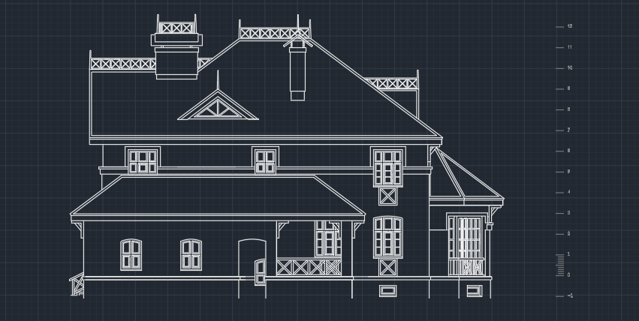
Step 4: Sketching
Figure 16: added side balcony

Slide 17
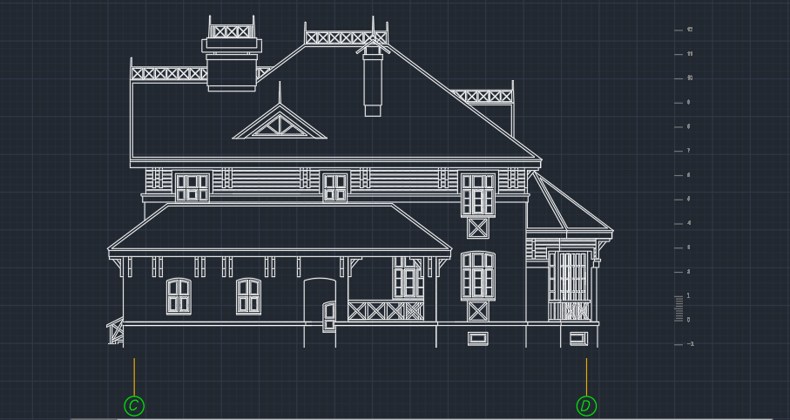
Step 4: Sketching
Figure 17: Final sketch (without hatch)

Slide 18
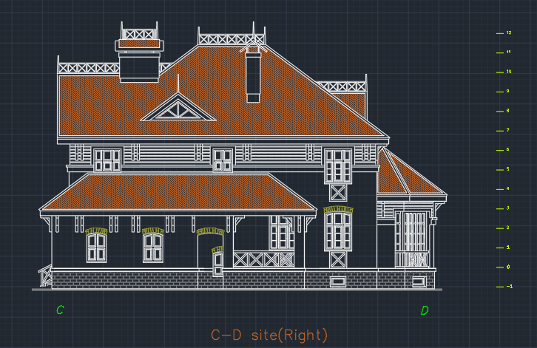
Step 5: Hatching
Figure 18: Hatched view

Slide 19
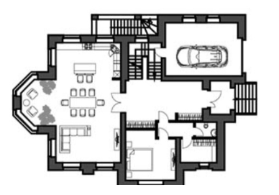
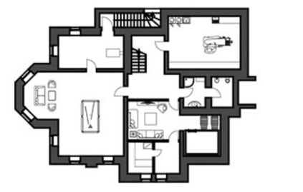
2 storied floor planning
Figure 19: Reference image of 2 floors

Slide 20
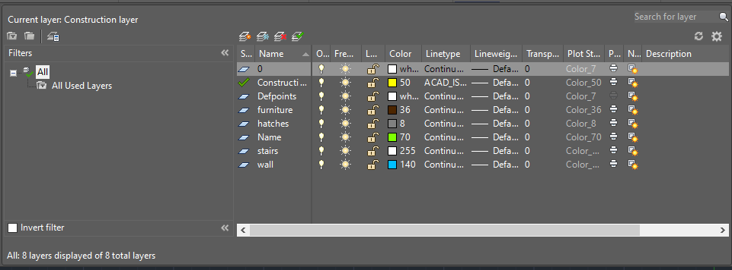
Step 1: Define Layers
In the sketch, there are 7 layers
in total.
Construction layer help to get the main shape of the floors, one layer for wall, one for hatch, one for furniture, one for stairs & one for labels.
Figure 20: All defined layers

Slide 21
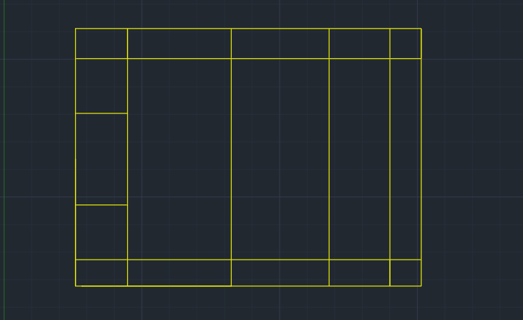
Step 2: Constructions line
Construction lines were drawn by the help of reference image for both floors which help to get the proper shape of the house.
Figure 21: Constructions line

Slide 22
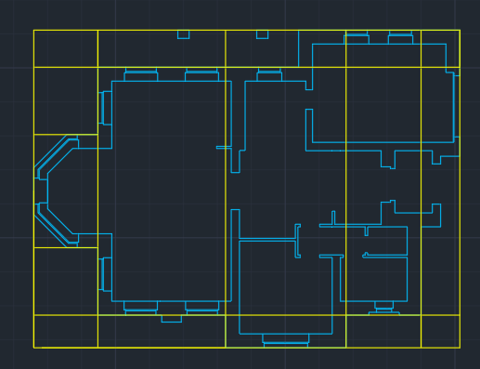
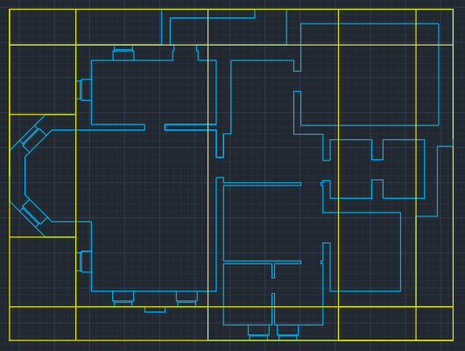
Step 3: Creating wall line
By the help of construction lines, wall lines were drawn for two floors.
Figure 22: Wall lines of ground and first floor

Slide 23
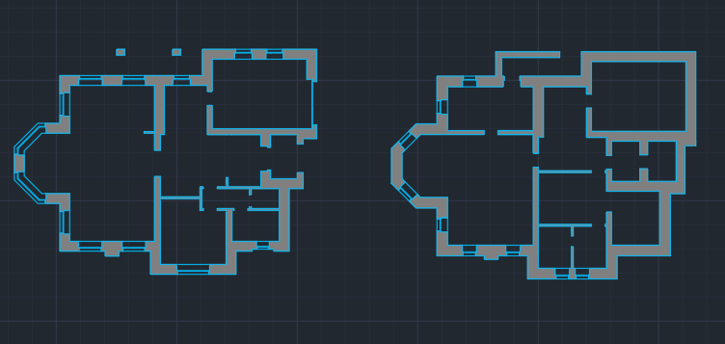
Step 4: Hatch wall line
After hatching, the wall will look like this.
Figure 23: Hatched wall line

Slide 24
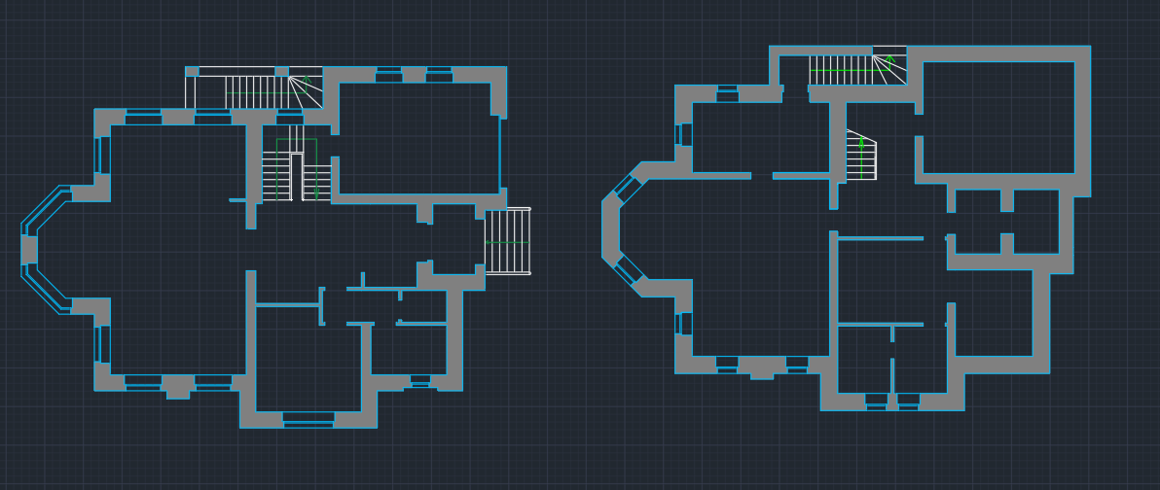
Step 5: Building Stairs
There are two types of stairs in this sketch. One is inside the house, another one is outside.
Figure 24: Adding stairs

Slide 25
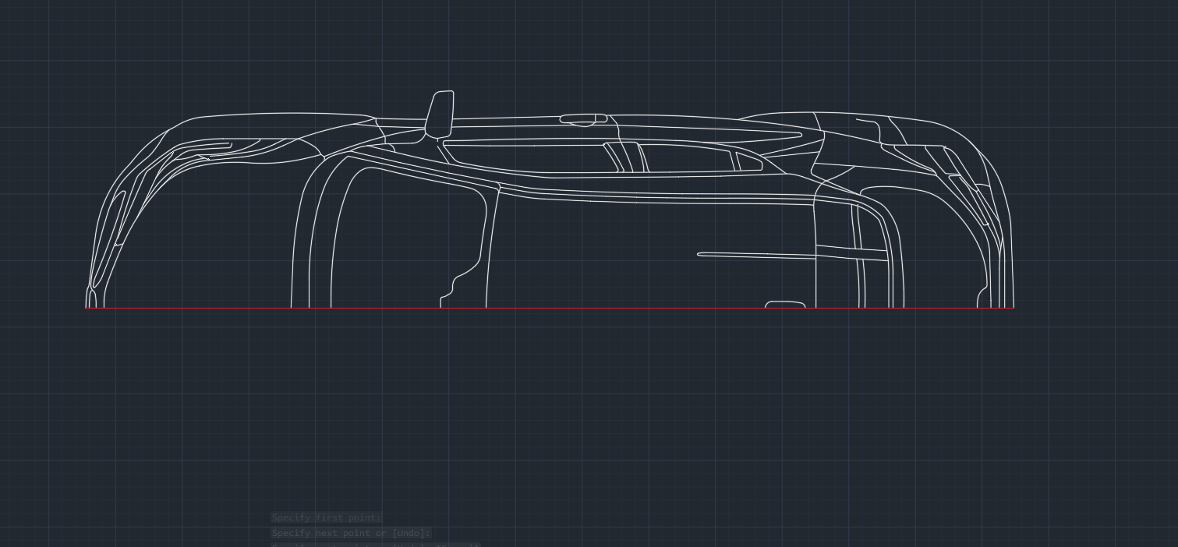
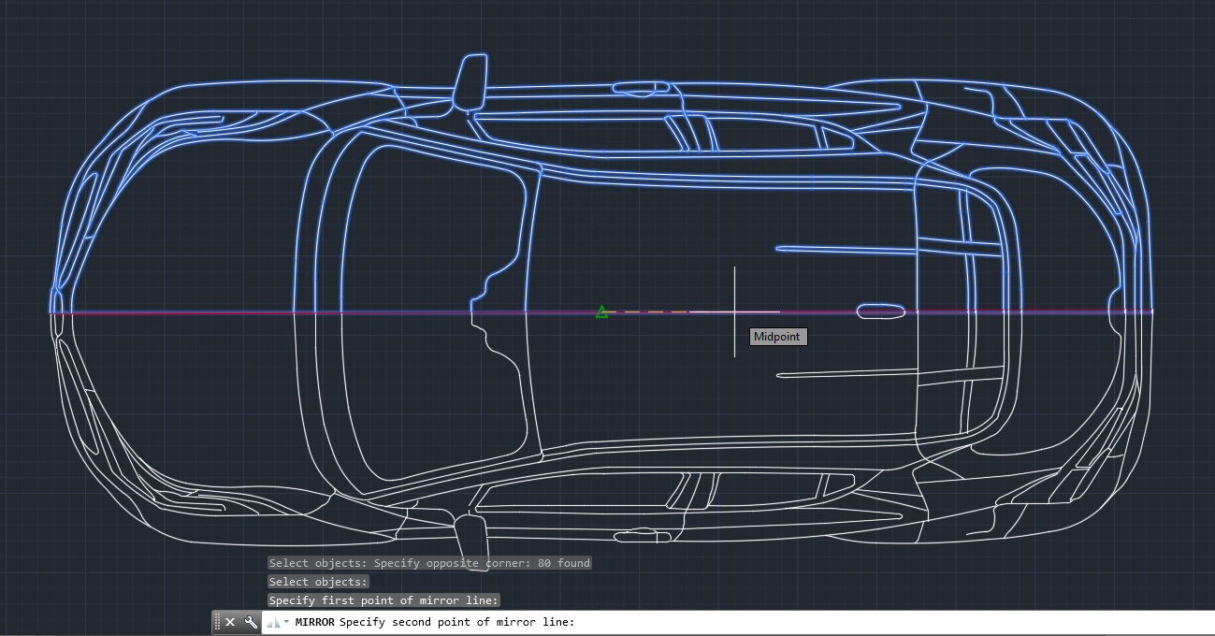
Step 6: Car for garage
Tracing tools are used for this. First Insert an image in AutoCAD window then tracing the half of the image.
Then using mirroring tools just duplicate the image to opposite site.
Figure 25: Car

Slide 26
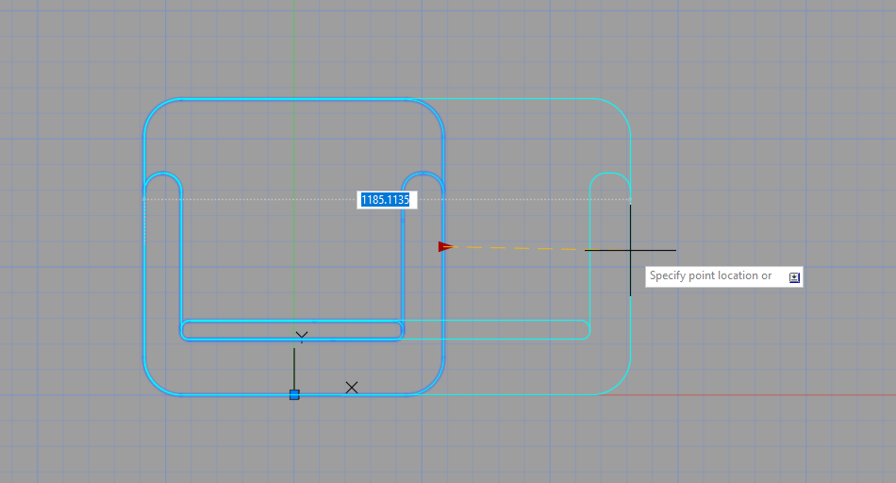
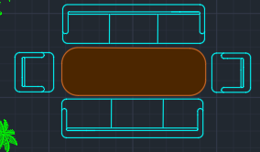
Step 7: Dynamic Sofa Block
First create a single sofa block main layer. Then using liner parameter; stretch and move action in block editor can simply make a dynamic Sofa for furniture layer.
Using this stretch action, large dining table chair also made.
Figure 26: Sofa

Slide 27
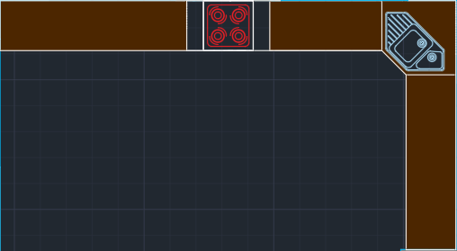
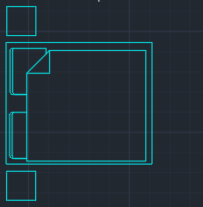
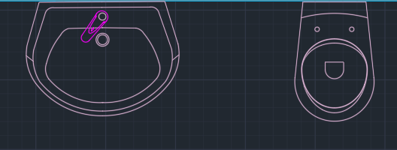
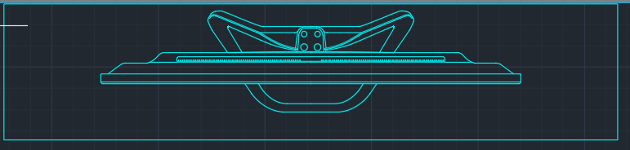
Step 8: Other furniture and components
Figure 27: Kitchen
Figure 28: Bed
Figure 29: Washroom components
Figure 30: TV set

Slide 28
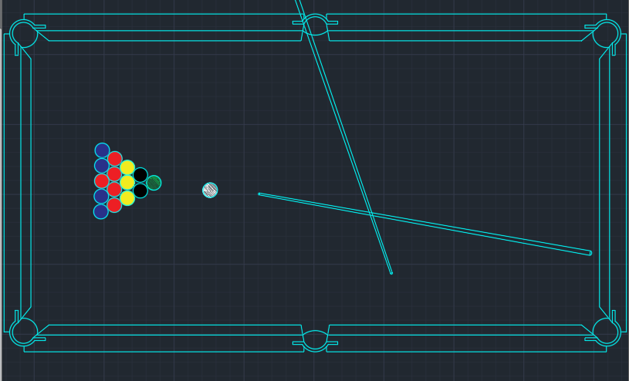

Step 8: Other furniture and components
Figure 32: Flowers
Figure 31: Pool table

Slide 29
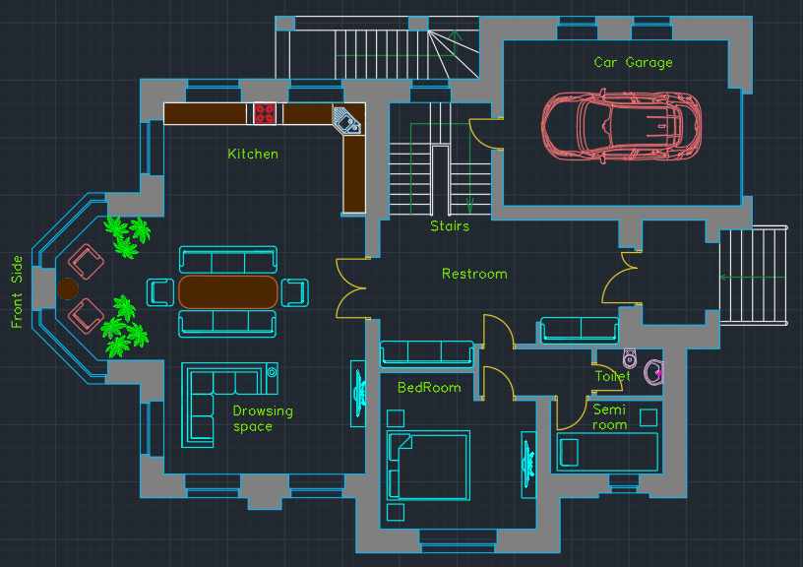
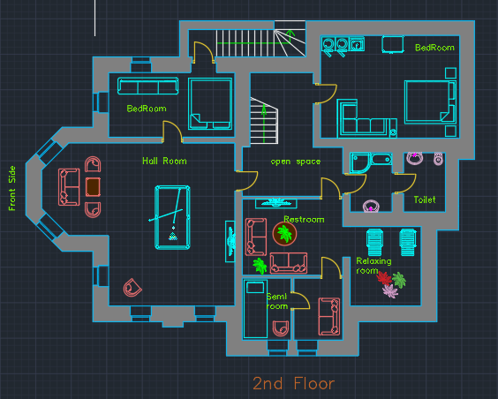
Step 9: Final Touch
Figure 33: Final sketch (Ground and first floor)

Slide 30
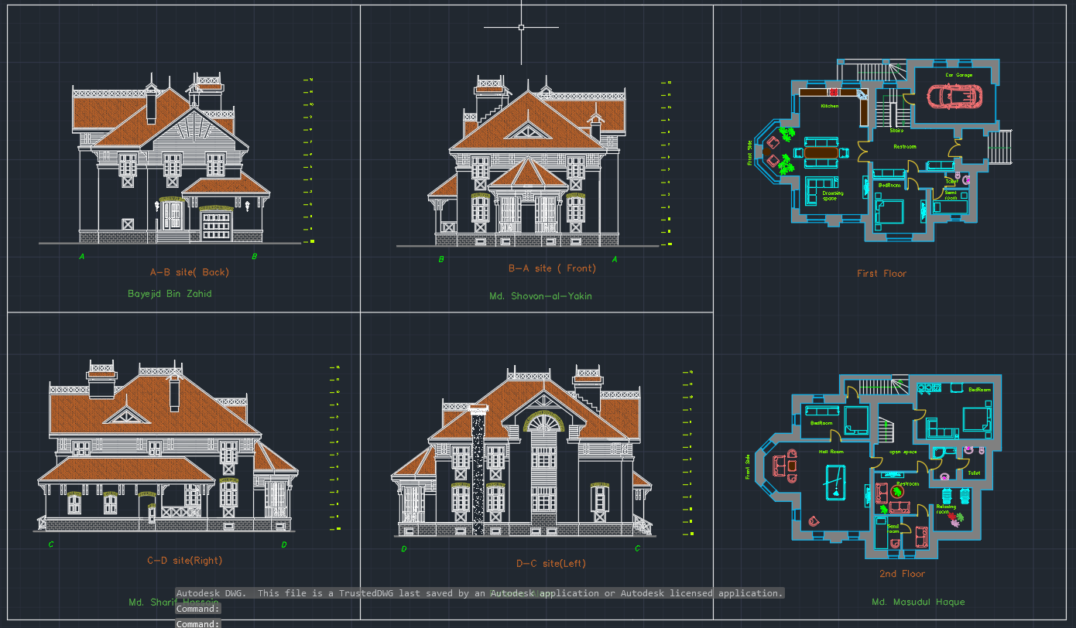
Final View
Figure 34: Final sketch

Slide 31
Thank You All!

Slide 32
?

